Slide 1
SUPPLEMENTARY STUDY SLIDES · BUAD 405 APPLIED ECONOMETRICS
Logistic Regression
Polish Companies Bankruptcy Case
Predicting corporate bankruptcy from financial ratios
Notes:
These slides supplement the R tutorial. Concepts are simple; jargon is intentional so students get used to it. One worked example runs through the whole deck.

Slide 2
THE RUNNING EXAMPLE
One dataset, one firm, all the way through
The Polish Bankruptcy dataset
DS
Delta Solutions
Unit of observation
One Polish company (a single firm-year).
Leverage (liabilities / assets): 0.78 Profitability (ROA): −0.04
Data
4year.arff — financial ratios from year 4, predicting bankruptcy within the next two years.
Outcome coding
Y = 1 bankrupt · Y = 0 non-bankrupt. Verify this before modelling.
Predictors (of 64)
What these slides add
We follow just two teaching ratios: Leverage and Profitability (ROA).
The R tutorial produces the output. These slides tell you how to read it — coefficients vs odds vs probabilities, model fit vs discrimination, and choosing a decision threshold that reflects a bank's risk appetite rather than a software default.
Class imbalance
Bankruptcy is rare (~5%). This is why accuracy alone will mislead us later.
Notes:
Anchor everything to one firm and one dataset. Stress class imbalance early — it foreshadows the threshold discussion.

Slide 3
MODULE 2 · PART C
Why not ordinary least squares?
Regressing a 0/1 outcome with OLS gives the Linear Probability Model (LPM). It is easy to fit — and structurally broken for probabilities.
!
Predicted probabilities escape [0, 1]
σ
Inherent heteroskedasticity
A straight line does not stop at 0 or 1. For a highly-levered firm the LPM can output P(bankrupt) = 1.18; for a very healthy one, −0.09. Negative and above-one “probabilities” are meaningless to a credit officer.
For a binary outcome the error variance equals p(1 − p), which changes with the predictors. OLS assumes constant variance, so standard errors are wrong and inference is unreliable — before we even reach interpretation.
1
fitted line exits the [0,1] band
Take-away: we need a model whose fitted values are guaranteed to be valid probabilities and whose error structure fits a 0/1 world.
0
Notes:
Two named failures: out-of-range predictions and heteroskedasticity. Both motivate the logit link on the next slide.

Slide 4
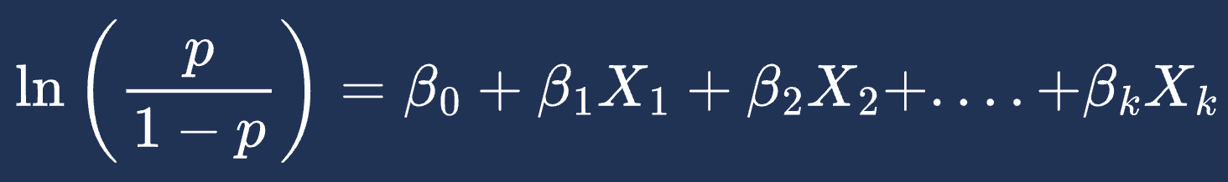
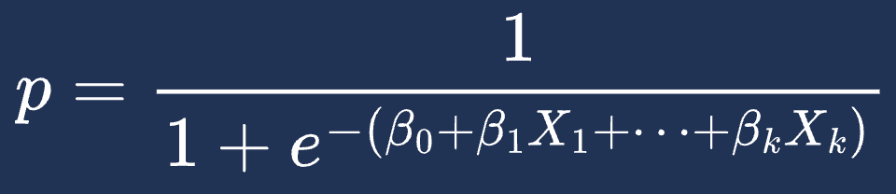
MODULE 2 · PART D
The logit transformation
Model the log-odds as linear. The inverse (logistic) function then squeezes any real number back into a clean probability.
Log-odds (logit) is linear in the predictors
The logistic S-curve
1
p = P(bankrupt = 1) · the left side ranges over all real numbers, so the right side is free to be linear.
P(bankrupt)
Invert it → a valid probability
0.5
Whatever the linear part equals — −40 or +40 — the output is trapped in (0, 1). No impossible probabilities. Problem from the last slide: solved.
0
β₀ + βX (log-odds) →
Notes:
Two equivalent views: linear log-odds, or the squashing S-curve. Emphasise the link function is what guarantees valid probabilities.

Slide 5
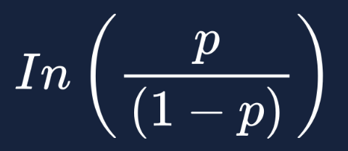


One equation we will read three ways
Estimated logit (glm, family = binomial)
ln( p / (1−p) ) = −2.94 + 0.34·Leverage − 0.36·ROA
Illustrative coefficients for teaching — your R session produces the real ones.
AME (marginal effect)
Sign of Leverage is +, so more debt → higher log-odds of bankruptcy. Magnitude is not a probability.
exp(0.34) = 1.40 → each +1 unit of leverage multiplies the odds of bankruptcy by 1.40.
+1 unit of leverage ≈ +2.1 percentage points on P(bankrupt). The number executives want.
Direction only
Multiplies the odds
Probability, in points
Notes:
Introduce the estimated equation once; the next four slides unpack each reading. Keep colour coding of Leverage/ROA consistent throughout.

Slide 6
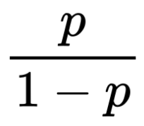
MODULE 3 · INTERPRETATION
Why AME Beats Raw Coefficients & Odds Ratios
AME (marginal effect)
The Problem:
Abstract & Non-Linear
The Problem:
Odds ≠ Probability
The Solution:
Clear & Actionable
• Conveys no intuitive sense of scale.
• A constant 𝛽 does NOT mean a constant effect on probability.
• Odds =
• A 40% rise in odds is NOT a 40% rise in probability.
• Stated directly in probability percentage points.
• Requires no mental gymnastics or translation.

Slide 7

MODULE 4 · PART F
Model fit: McFadden's pseudo-R²
Definition
Our model
0.28
= 1 − (−540 / −750) Excellent fit in the logit world.
Compares your model's log-likelihood against an intercept-only (null) model.
!
Rule-of-thumb scale
Take Care
0.0 – 0.10
weak
Never read McFadden's R² as “percent of variance explained.” It is not an OLS R². Its scale is compressed — values that look small are actually strong.
0.10 – 0.20
reasonable
0.20 – 0.40
excellent ← us
Notes:
Two messages: what it compares (full vs null log-likelihood) and the calibration trap. 0.28 is genuinely strong here.

Slide 8
MODULE 4 · PART H
Discrimination: the ROC curve & AUC
Fit tells you how well the model matches the data; discrimination tells you how well it RANKS risky firms above healthy ones — across every possible threshold.
ROC curve — pROC::roc()
0.50
No better than a coin flip — the model cannot separate bankrupt from solvent firms.
True positive rate →
0.82
Our model: strong ranking. A random bankrupt firm scores higher than a random solvent firm 82% of the time.
AUC = 0.82
chance = 0.50
1.00
Perfect discrimination — every bankrupt firm ranked above every solvent one (unrealistic).
False positive rate →
AUC is threshold-independent — it judges ranking, before any cutoff is chosen.
Notes:
Separate fit from discrimination. AUC = probability a random positive outranks a random negative. Independent of threshold — bridges to Module 5.

Slide 9
MODULE 5 · PART G
Asymmetric risk: not all errors cost the same
Confusion matrix
FP
False positive — small cost
Actual bankrupt (1)
Actual solvent (0)
Predict 1
TP
FP
Reject a healthy firm's credit line → lost interest income. Recoverable — you find another borrower.
True positive
False positive · Type I
Predict 0
FN
TN
False negative · Type II
True negative
FN
False negative — massive cost
Default software cutoff: classify as bankrupt when p ≥ 0.50.
Approve a loan to a firm that then defaults → loss of the entire principal. An order of magnitude worse than a false positive.
Notes:
Introduce TP/FP/FN/TN and immediately load them with asymmetric cost. FN = losing principal; FP = losing interest. Sets up why 0.50 is wrong.

Slide 10
MODULE 6 · PART I
Communicate without claiming causation
This is observational credit data, not a randomised experiment. The model finds association and predicts risk — it does not prove that changing a ratio changes the outcome.
✕
Causal
✓
Associational
✕ “Raising leverage causes bankruptcy.”
✓ “Higher leverage is associated with higher predicted risk.”
✕ “Cutting debt will reduce a firm's default risk by 2.1 points.”
✓ “Firms with higher leverage tend to have ~2.1 pts higher probability, holding other ratios fixed.”
✕ “Profitability drives firms out of distress.”
✓ “Profitability is a strong predictor of lower default risk.”
Safe verbs: “associated with”, “predicts”, “tends to”, “holding other ratios constant.” Avoid: “causes”, “drives”, “leads to”, “because of.”
Notes:
Correct causal language immediately in briefings. Give students a verb swap-list. Observational data -> association and prediction, never causation.

